Slide 1

Machine Learning
ICT-4261
By-
Dr. Jesmin Akhter
Professor
Institute of Information Technology
Jahangirnagar University

Slide 2
Contents
The course will mainly cover the following topics:
A Gentle Introduction to Machine Learning
Important Elements in Machine Learning
Linear Regression
Logistic Regression
Naive Bayes
Support Vector Machines
Decision Trees and Ensemble Learning
Neural Networks and Deep Learning
Unsupervised Learning

Slide 3
Outline
Neural Networks

Slide 4
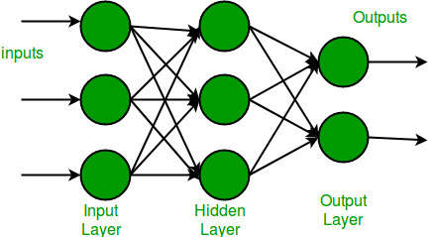
Neural Networks
Neural Networks are inspired by the most complex object in the universe – the human brain.
Let us understand how the brain works first.
The human brain is made up of something called Neurons. A neuron is the most basic computational unit of any neural network, including the brain. Neurons take input, process it, and pass it on to other neurons present in the multiple hidden layers of the network, till the processed output reaches the Output Layer.
In its simplest form, an Artificial Neural Network (ANN) has only three layers – the input layer, the output layer, and a hidden layer.

Slide 5
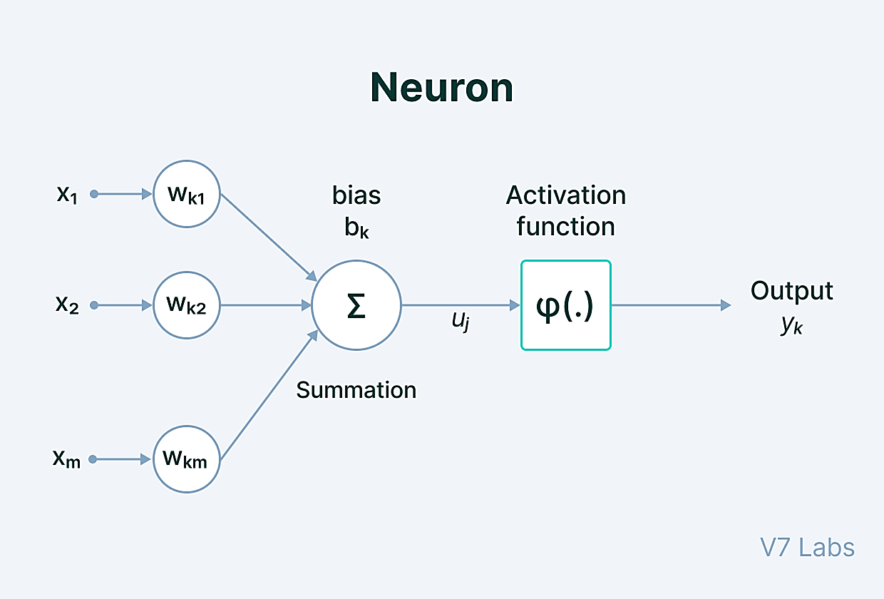
Key Components of the Neural Network Architecture
The Neural Network architecture is made of individual units called neurons that mimic the biological behavior of the brain.
Here are the various components of a neuron.

Slide 6
Key Components of the Neural Network Architecture
Input - It is the set of features that are fed into the model for the learning and training process. For example, the input in object detection can be an array of pixel values pertaining to an image.
Weight - Its main function is to give importance to those features that contribute more towards the learning. It does so by introducing scalar multiplication between the input value and the weight matrix. For example, a negative word would impact the decision of the sentiment analysis model more than a pair of neutral words.
Transfer function - The job of the transfer function is to combine multiple inputs into one output value so that the activation function can be applied. It is done by a simple summation of all the inputs to the transfer function.
Activation Function—The role of the activation function is to decide whether or not a specific neuron should be activated. This decision is based on whether or not the neuron’s input will be important to the prediction process
Bias - The role of bias is to shift the value produced by the activation function. Its role is similar to the role of a constant in a linear function.
Notes:
Input - Input is data that is put into the model for learning and training purposes.
Weight - Weight helps organize the variables by importance and impact of contribution.
Transfer function - Transfer function is when all the inputs are summarized and combined into one output variable.
Activation function - The role of the activation function is to decide whether or not a specific neuron should be activated. This decision is based on whether or not the neuron’s input will be important to the prediction process.
Bias - Bias shifts the value given by the activation function.

Slide 7

Key Components of the Neural Network Architecture
When multiple neurons are stacked together in a row, they constitute a layer, and multiple layers piled next to each other are called a multi-layer neural network.
Multi-layer neural network

Slide 8
Key Components of the Neural Network Architecture
Input Layer
The data that we feed to the model is loaded into the input layer from external sources like a CSV file or a web service. It is the only visible layer in the complete Neural Network architecture that passes the complete information from the outside world without any computation.
Hidden Layers
The hidden layers are what makes deep learning what it is today. They are intermediate layers that do all the computations and extract the features from the data.
There can be multiple interconnected hidden layers that account for searching different hidden features in the data. For example, in image processing, the first hidden layers are responsible for higher-level features like edges, shapes, or boundaries. On the other hand, the later hidden layers perform more complicated tasks like identifying complete objects (a car, a building, a person).

Slide 9
Key Components of the Neural Network Architecture
Output Layer
The output layer takes input from preceding hidden layers and comes to a final prediction based on the model’s learnings. It is the most important layer where we get the final result.
In the case of classification/regression models, the output layer generally has a single node. However, it is completely problem-specific and dependent on the way the model was built.

Slide 10
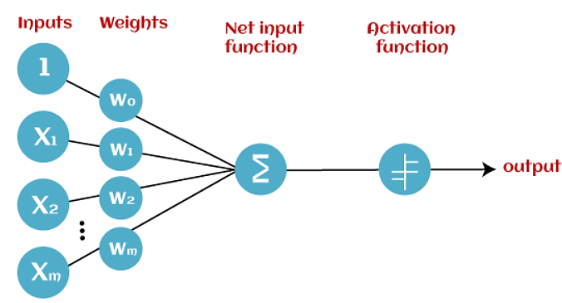
Standard Neural Networks
The Perceptron
Perceptron is the simplest Neural Network architecture. it acts as a single-layer neural network with four main parameters, i.e., input values, weights and Bias, net sum, and an activation function.
It is a type of Neural Network that takes a number of inputs, applies certain mathematical operations on these inputs, and produces an output. It takes a vector of real values inputs, performs a linear combination of each attribute with the corresponding weight assigned to each of them.
The weighted input is summed into a single value and passed through an activation function.
These perceptron units are combined to form a bigger Artificial Neural Network architecture.
Notes:
Perceptron is a linear Machine Learning algorithm used for supervised learning for various binary classifiers. This algorithm enables neurons to learn elements and processes them one by one during preparation.

Slide 11
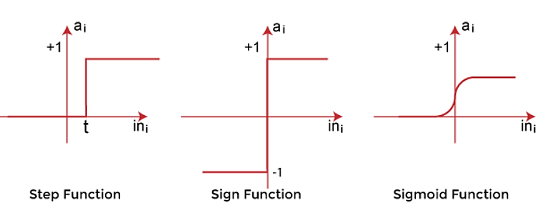
The Perceptron
Input values:
This is the primary component of Perceptron which accepts the initial data into the system for further processing. Each input node contains a real numerical value.
Wight and Bias:
Weight parameter represents the strength of the connection between units. This is another most important parameter of Perceptron components. Weight is directly proportional to the strength of the associated input neuron in deciding the output. Further, Bias can be considered as the line of intercept in a linear equation.
Activation Function:
These are the final and important components that help to determine whether the neuron will fire or not. Activation Function can be considered primarily as a step function.
Types of Activation functions:
Sign function
Step function, and
Sigmoid function
The data scientist uses the activation function to take a subjective decision based on various problem statements and forms the desired outputs. Activation function may differ (e.g., Sign, Step, and Sigmoid) in perceptron models by checking whether the learning process is slow or has vanishing or exploding gradients.

Slide 12
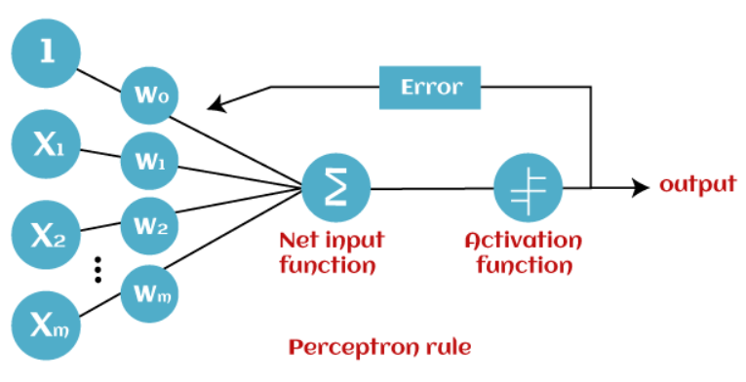
How does Perceptron work?
In Machine Learning, Perceptron is considered as a single-layer neural network that consists of four main parameters named input values (Input nodes), weights and Bias, net sum, and an activation function. The perceptron model begins with the multiplication of all input values and their weights, then adds these values together to create the weighted sum. Then this weighted sum is applied to the activation function 'f' to obtain the desired output. This activation function is also known as the step function and is represented by 'f'.

Slide 13
How does Perceptron work?
This step function or Activation function plays a vital role in ensuring that output is mapped between required values (0,1) or (-1,1). It is important to note that the weight of input is indicative of the strength of a node. Similarly, an input's bias value gives the ability to shift the activation function curve up or down.
Perceptron model works in two important steps as follows:
Step-1
In the first step first, multiply all input values with corresponding weight values and then add them to determine the weighted sum. Mathematically, we can calculate the weighted sum as follows:
∑wi*xi = x1*w1 + x2*w2 +…wn*xn
Add a special term called bias 'b' to this weighted sum to improve the model's performance.
∑wi*xi + b
Step-2
In the second step, an activation function is applied with the above-mentioned weighted sum, which gives us output either in binary form or a continuous value as follows:
Y = f(∑wi*xi + b)

Slide 14
The Perceptron
Based on the layers, Perceptron models are divided into two types. These are as follows:
Single-layer Perceptron Model
Multi-layer Perceptron model
Single Layer Perceptron Model:
This is one of the easiest Artificial neural networks (ANN) types. A single-layered perceptron model consists feed-forward network and also includes a threshold transfer function inside the model. The main objective of the single-layer perceptron model is to analyze the linearly separable objects with binary outcomes.
In a single layer perceptron model, its algorithms do not contain recorded data, so it begins with inconstantly allocated input for weight parameters. Further, it sums up all inputs (weight). After adding all inputs, if the total sum of all inputs is more than a pre-determined value, the model gets activated and shows the output value as +1.
If the outcome is same as pre-determined or threshold value, then the performance of this model is stated as satisfied, and weight demand does not change. However, this model consists of a few discrepancies triggered when multiple weight inputs values are fed into the model. Hence, to find desired output and minimize errors, some changes should be necessary for the weights input.
"Single-layer perceptron can learn only linearly separable patterns."

Slide 15
The Perceptron
Multi-Layered Perceptron Model:
Like a single-layer perceptron model, a multi-layer perceptron model also has the same model structure but has a greater number of hidden layers.
The multi-layer perceptron model is also known as the Backpropagation algorithm, which executes in two stages as follows:
Forward Stage: Activation functions start from the input layer in the forward stage and terminate on the output layer.
Backward Stage: In the backward stage, weight and bias values are modified as per the model's requirement. In this stage, the error between actual output and demanded originated backward on the output layer and ended on the input layer.
Hence, a multi-layered perceptron model has considered as multiple artificial neural networks having various layers in which activation function does not remain linear, similar to a single layer perceptron model. Instead of linear, activation function can be executed as sigmoid, TanH, ReLU, etc., for deployment.
A multi-layer perceptron model has greater processing power and can process linear and non-linear patterns. Further, it can also implement logic gates such as AND, OR, XOR, NAND, NOT, XNOR, NOR.

Slide 16
Advantages of Multi-Layer Perceptron:
A multi-layered perceptron model can be used to solve complex non-linear problems.
It works well with both small and large input data.
It helps us to obtain quick predictions after the training.
It helps to obtain the same accuracy ratio with large as well as small data.
Disadvantages of Multi-Layer Perceptron:
In Multi-layer perceptron, computations are difficult and time-consuming.
In multi-layer Perceptron, it is difficult to predict how much the dependent variable affects each independent variable.
The model functioning depends on the quality of the training.

Slide 17
Standard Neural Networks
Feed-Forward Networks
Perceptron represents how a single neuron works. But—What about a series of perceptrons stacked in a row and piled in different layers? How does the model learn then?
It is a multi-layer Neural Network, and, as the name suggests, the information is passed in the forward direction—from left to right.
In the forward pass, the information comes inside the model through the input layer, passes through the series of hidden layers, and finally goes to the output layer. This Neural Networks architecture is forward in nature—the information does not loop with two hidden layers.
The later layers give no feedback to the previous layers. The basic learning process of Feed-Forward Networks remain the same as the perceptron. It uses nonlinear activation functions.
Notes:
Perceptron is a linear Machine Learning algorithm used for supervised learning for various binary classifiers. This algorithm enables neurons to learn elements and processes them one by one during preparation.

Slide 18
Standard Neural Networks
Residual Networks (ResNet)
Now that you know more about the Feed-Forward Networks, one question might have popped up in your head—how to decide on the number of layers in our neural network architecture?
A naive answer would be: The greater the number of hidden layers, the better is the learning process.
More layers enrich the levels of features.But—
Is that so?
Very deep Neural Networks are extremely difficult to train due to vanishing and exploding gradient problems.
ResNets provide an alternate pathway for data to flow to make the training process much faster and easier.
This is different from the feed-forward approach of earlier Neural Networks architectures.
The core idea behind ResNet is that a deeper network can be made from a shallow network by copying weight from the shallow counterparts using identity mapping.
The data from previous layers is fast-forwarded and copied much forward in the Neural Networks. This is what we call skip connections first introduced in Residual Networks to resolve vanishing gradients.

Slide 19
Standard Neural Networks
Recurrent Neural.
Also, the decisions made by the model were based on the current input with no memory of the past.
Recurrent Neural Networks work very well with sequences of data as input. Its functionality can be seen in solving NLP problems like sentiment analysis, spam filters, time series problems like sales forecasting, stock market prediction, etc.

Slide 20
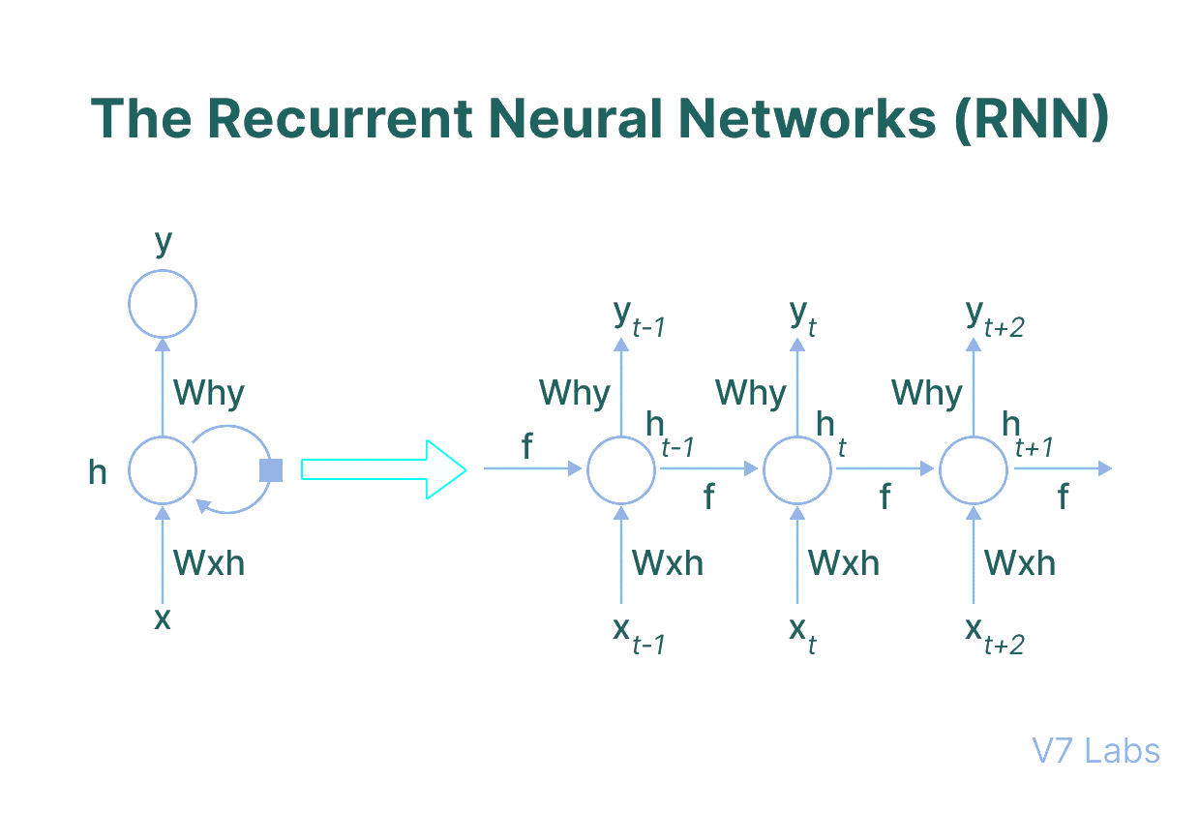
Standard Neural Networks
The Recurrent Neural Networks (RNN)
Recurrent Neural Networks have the power to remember what it has learned in the past and apply it in future predictions. Networks (RNNs)
The basic deep learning architecture has a fixed input size, and this acts as a blocker in scenarios where the input size is not fixed
The input is in the form of sequential data that is fed into the RNN, which has a hidden internal state that gets updated every time it reads the following sequence of data in the input.
The internal hidden state will be fed back to the model. The RNN produces some output at every timestamp.

Slide 21
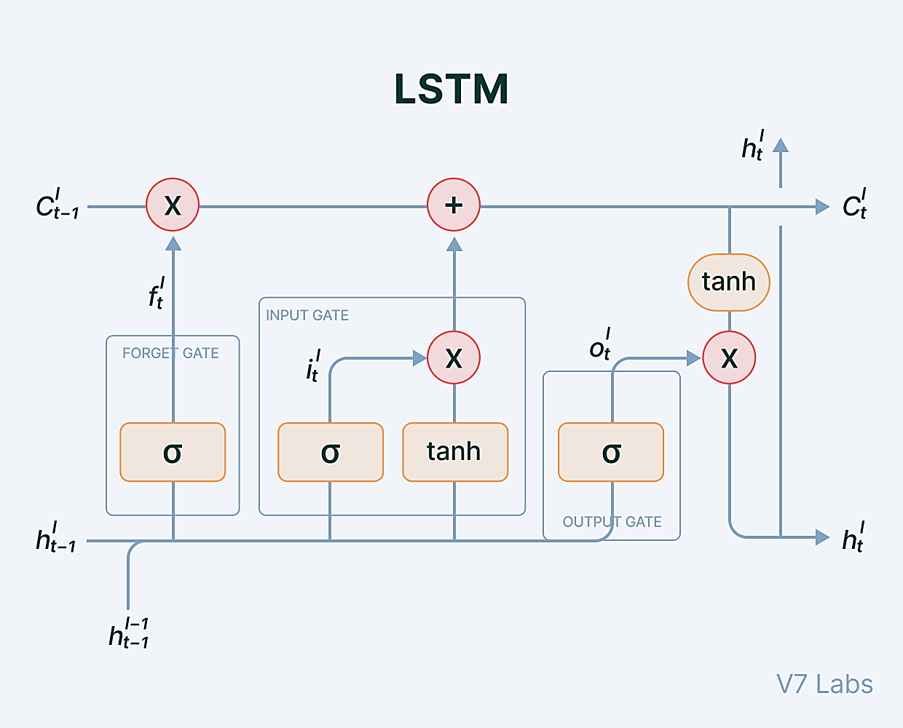
Standard Neural Networks
The Long Short Term Memory Network (LSTM)
In RNN each of our predictions looked only one timestamp back, and it has a very short-term memory. It doesn't use any information from further back.
To rectify this, we can take our Recurrent Neural Networks structure and expand it by adding some more pieces to it.
The critical part that we add to this Recurrent Neural Networks is memory. We want it to be able to remember what happened many timestamps ago. To achieve this, we need to add extra structures called gates to the artificial neural network structure.

Slide 22
Standard Neural Networks
Cell state (c_t): It corresponds to the long-term memory content of the network.
Forget Gate: Some information in the cell state is no longer needed and is erased. The gate receives two inputs, x_t (current timestamp input) and h_t-1 (previous cell state), multiplied with the relevant weight matrices before bias is added. The result is sent into an activation function, which outputs a binary value that decides whether the information is retained or forgotten.
Input gate: It decides what piece of new information is to be added to the cell state. It is similar to the forget gate using the current timestamp input and previous cell state with the only difference of multiplying with a different set of weights.
Output gate: The output gate's job is to extract meaningful information from the current cell state and provide it as an output.

Slide 23
Standard Neural Networks
Echo State Networks (ESN)
Echo state Networks is a RNN with sparsely connected hidden layers with typically 1% connectivity.
The connectivity and weight of hidden neurons are fixed and randomly assigned. The only weight that needs to be learned is that of the output layer. It can be seen as a linear model of the weighted input passed through all the hidden layers and the targeted output. The main idea is to keep the early layers fixed.
The only weights that will be modified during the training are for the synopsis that connects the hidden layers to the output layers. This makes the loss function simple and easy to differentiate.
The training becomes uncomplicated, assuming linear output units. The only thing to keep in mind is to set the random connections very carefully.

Slide 24
Standard Neural Networks
Convolutional Neural Networks (CNNs)
Convolutional Neural Networks is a type of Feed-Forward Neural Networks used in tasks like image analysis, natural language processing, and other complex image classification problems.
A CNN has hidden layers of convolutional layers that form the base of ConvNets.
Features refer to minute details in the image data like edges, borders, shapes, textures, objects, circles, etc.
At a higher level, convolutional layers detect these patterns in the image data with the help of filters. The higher-level details are taken care of by the first few convolutional layers.
The deeper the network goes, the more sophisticated the pattern searching becomes.
For example, in later layers rather than edges and simple shapes, filters may detect specific objects like eyes or ears, and eventually a cat, a dog, and what not.

Slide 25
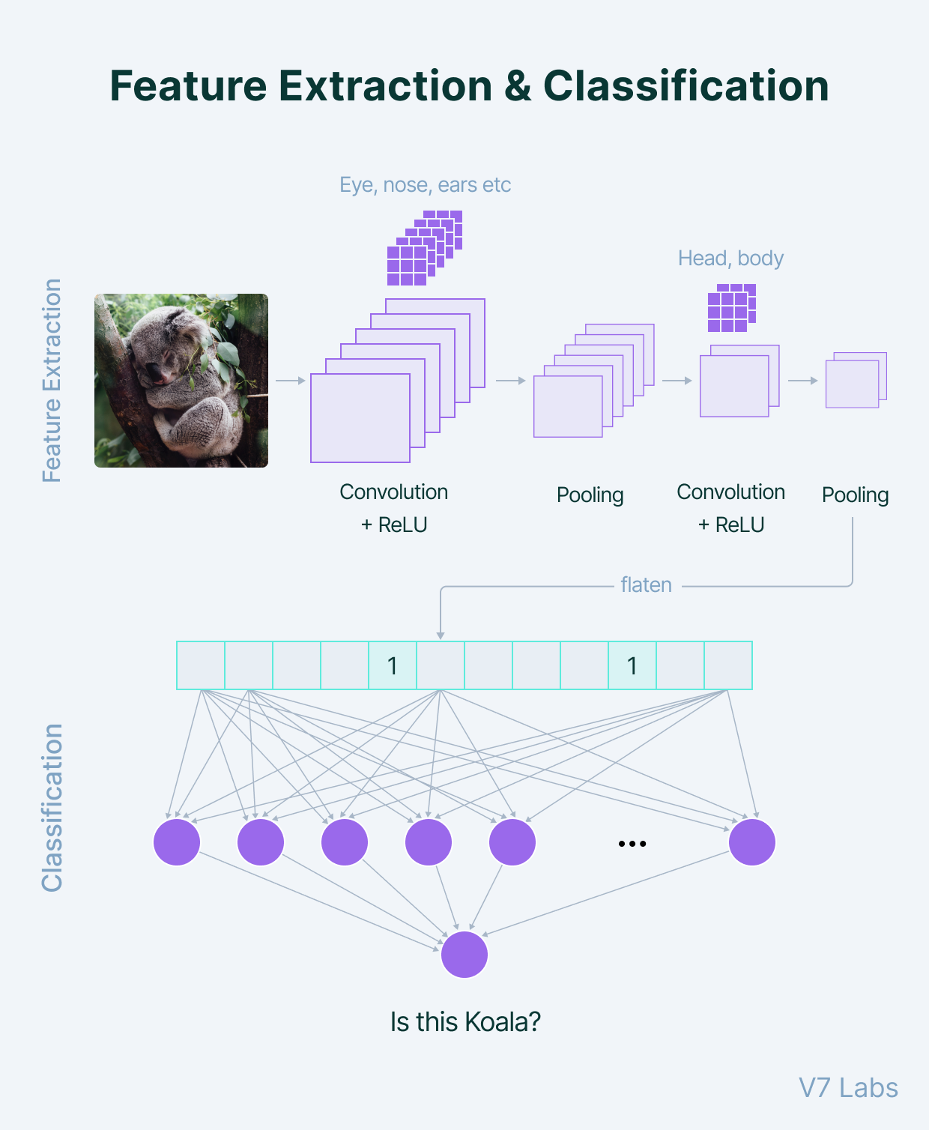
Standard Neural Networks
When adding a convolutional layer to a network, we need to specify the number of filters.
A filter can be thought of as a relatively small matrix for which we decide the number of rows and columns this matrix has.
The value of this feature matrix is initialized with random numbers. When this convolutional layer receives pixel values of input data, the filter will convolve over each patch of the input matrix.
The output of the convolutional layer is usually passed through the ReLU activation function to bring non-linearity to the model. It takes the feature map and replaces all the negative values with zero.
Pooling is a very important step in the ConvNets as it reduces the computation and makes the model tolerant towards distortions and variations. A Fully Connected Dense Neural Networks would use a flattened feature matrix and predict according to the use case.

Slide 26
Standard Neural Networks
CNNs use features such as edges, shapes, and textures to detect patterns. Examples of CNNs include:
AlexNet - Contains multiple convolutional layers designed for image recognition.
Visual geometry group (VGG) - VGG is similar to AlexNet, but has more layers of narrow convolutions.
Capsule networks - Contain nested capsules (groups of neurons) to create a more powerful CNN.

Slide 27
Standard Neural Networks
Sequence-to-Sequence (Seq2Seq): A type of neural network that uses two RNNs to map input sequences to output sequences, such as translating one language to another.
Shallow Neural Network: A neural network with only one hidden layer, often used for simpler tasks or as a building block for larger networks.

Slide 28
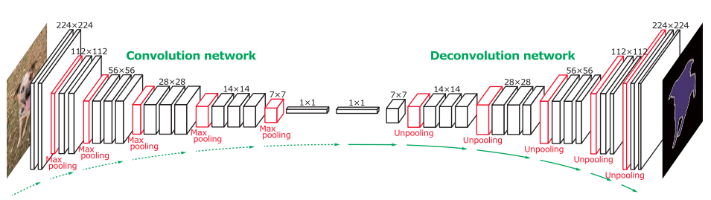
Standard Neural Networks
The Deconvolutional Neural Networks (DNN)
Deconvolutional Neural Networks are CNNs that work in a reverse manner.
When we use convolutional layers and max-pooling, the size of the image is reduced. To go to the original size, we use upsampling and transpose convolutional layers. Upsampling does not have trainable parameters—it just repeats the rows and columns of the image data by its corresponding sizes.
Transpose Convolutional layer means applying convolutional operation and upsampling at the same time. It is represented as Conv2DTranspose (number of filters, filter size, stride). If we set stride=1, we do not have any upsampling and receive an output of the same input size.

Slide 29
Neural Networks
How Neural Network Architecture works
Neural Network Architecture operates through a series of interconnected layers that transform input data into meaningful representations. The input layer receives the raw data, which is then passed through one or more hidden layers that perform mathematical computations. The output layer produces the final results, such as predictions or classifications.
The connections between neurons are represented by weights, which determine the strength and influence of the inputs on the neuron's output. During the training phase, the neural network adjusts the weights based on the provided data and the desired outcomes, gradually improving its ability to make accurate predictions or classifications.
Notes:
What is Raw Data?
Raw Data refers to unprocessed information that is collected and stored in its original format. It is the most fundamental form of data, captured directly from various sources, such as sensors, devices, or databases.
Raw Data is typically characterized by its lack of structure, organization, or meaningful interpretation. It may include text files, log files, images, audio recordings, or numeric data.
How Raw Data Works
Raw Data is acquired from different sources and stored as-is without any transformations or modifications. It can be collected manually or automatically through various methods, such as data extraction tools, IoT devices, or data streaming technologies.
Once the Raw Data is collected, it can be stored in databases, data warehouses, or data lakes, where it awaits further processing and analysis.

Slide 30
Neural Networks
Why Neural Network Architecture is important
Neural Network Architecture is crucial for several reasons:
Enhanced data processing: Neural networks can handle large volumes of complex data, making them effective in tasks such as image recognition, natural language processing, and sentiment analysis.
Flexibility and adaptability: The architecture can be customized and optimized for different data types and problem domains, allowing businesses to tailor neural networks to their specific needs.
Improved accuracy: Well-designed architectures can improve the accuracy of predictions or classifications by capturing complex patterns and relationships in the data.
Automatic feature extraction: Neural network architectures can automatically learn and extract relevant features from raw data, eliminating the need for manual feature engineering.
Notes:
What is Raw Data?
Raw Data refers to unprocessed information that is collected and stored in its original format. It is the most fundamental form of data, captured directly from various sources, such as sensors, devices, or databases.
Raw Data is typically characterized by its lack of structure, organization, or meaningful interpretation. It may include text files, log files, images, audio recordings, or numeric data.
How Raw Data Works
Raw Data is acquired from different sources and stored as-is without any transformations or modifications. It can be collected manually or automatically through various methods, such as data extraction tools, IoT devices, or data streaming technologies.
Once the Raw Data is collected, it can be stored in databases, data warehouses, or data lakes, where it awaits further processing and analysis.

Slide 31
Neural Networks
The most important Neural Network Architecture use cases
Neural Network Architecture finds applications in various domains, including:
Image and speech recognition: Neural networks can identify objects, people, and speech patterns in images and audio.
Natural language processing: Neural networks can understand and generate human language, enabling chatbots, machine translation, and sentiment analysis.
Recommendation systems: Neural networks can analyze user behavior and preferences to provide personalized recommendations, as seen in streaming platforms, e-commerce, and social media.
Financial forecasting: Neural networks can predict stock prices, market trends, and financial risks by analyzing historical data.
Healthcare diagnostics: Neural networks can assist in disease diagnosis, medical imaging analysis, and drug discovery.
Notes:
What is Natural Language Processing?
Natural Language Processing (NLP) is a branch of artificial intelligence that deals with the interaction between computers and human language. It involves the development of models and algorithms that enable computers to understand, interpret, and generate human language in a way that is both meaningful and useful.

Slide 32
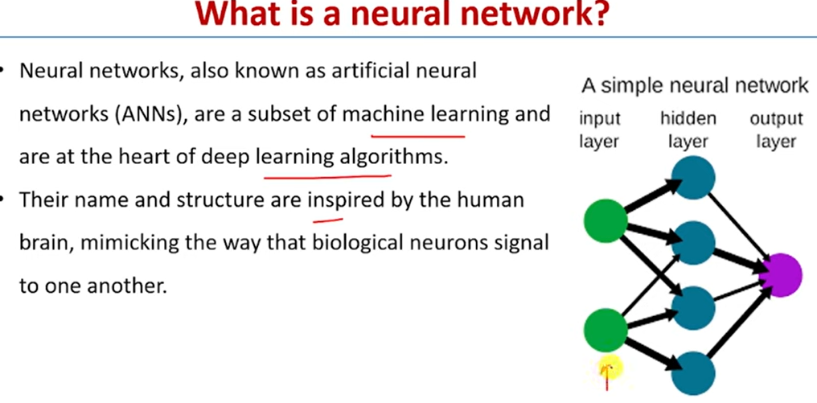

Slide 33
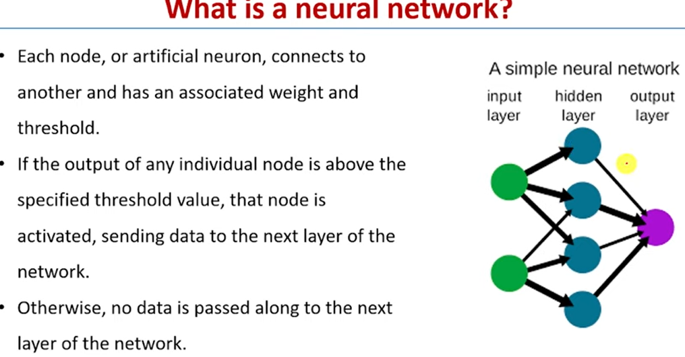

Slide 34
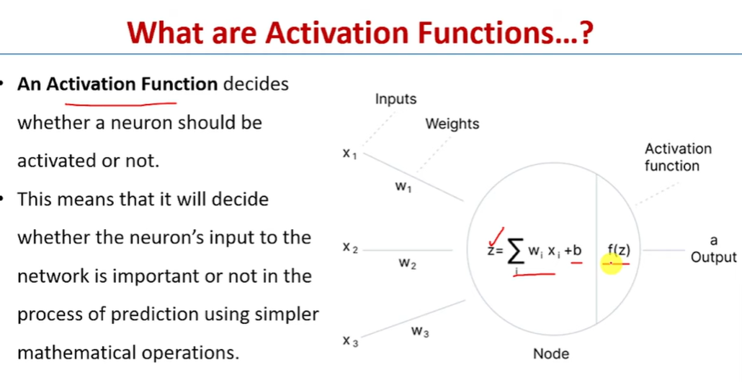

Slide 35
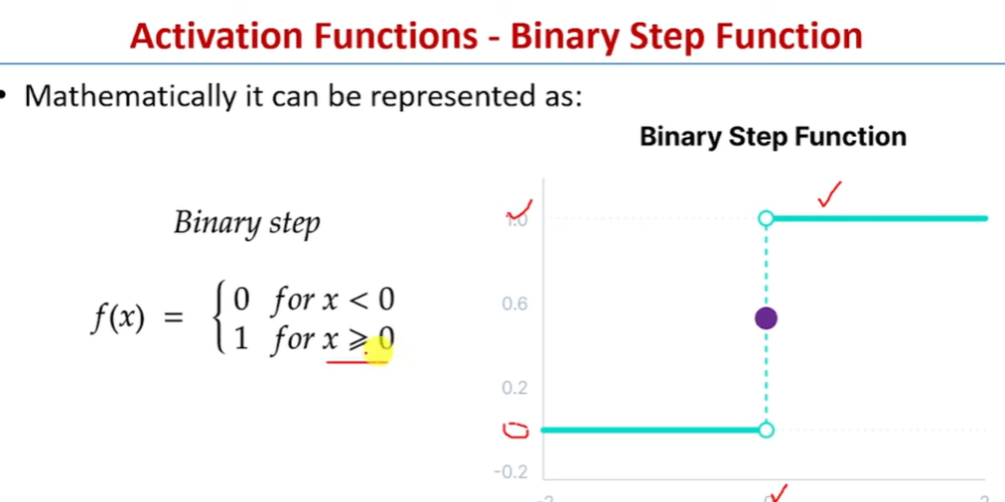

Slide 36
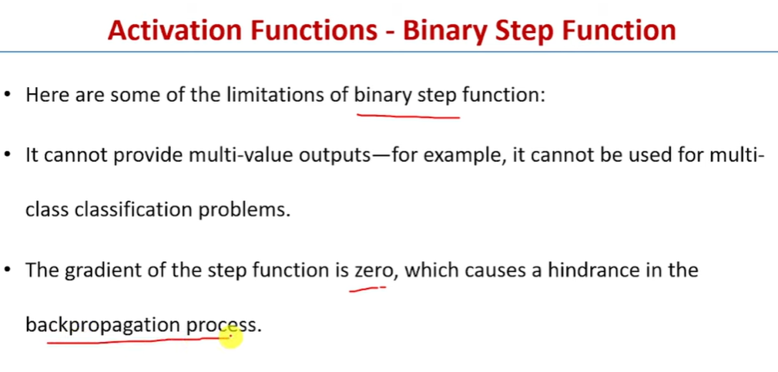

Slide 37
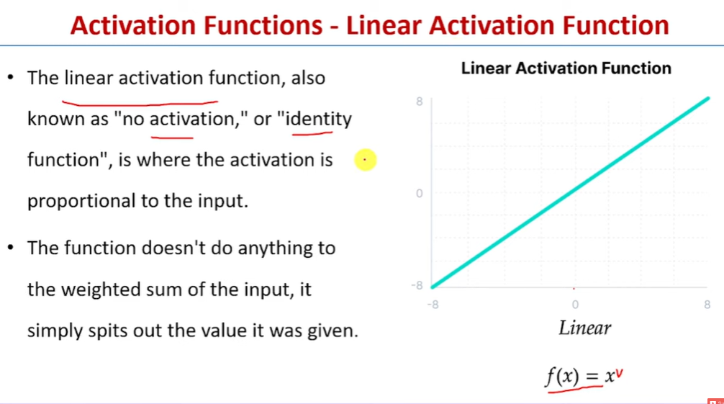

Slide 38
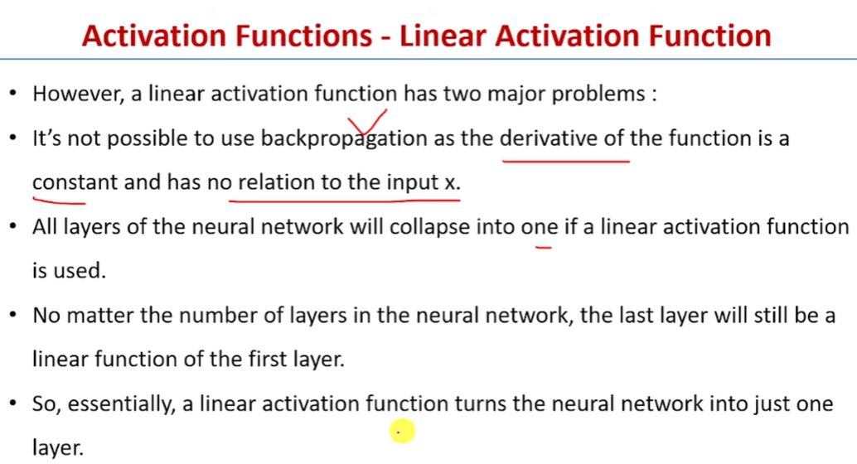

Slide 39
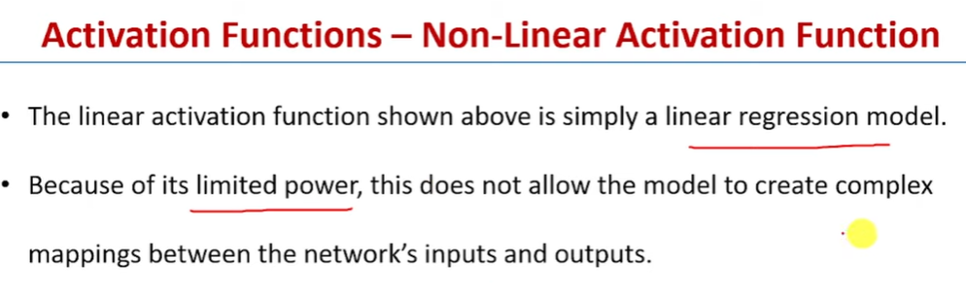

Slide 40
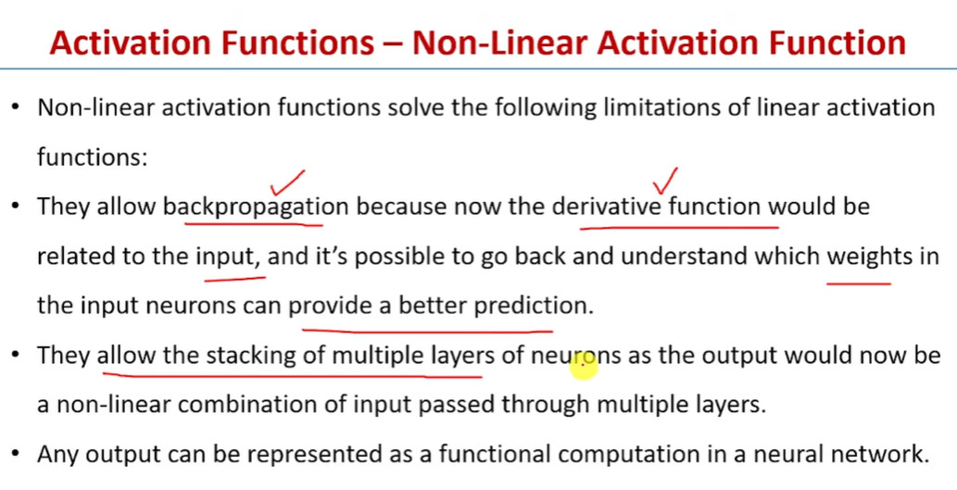

Slide 41
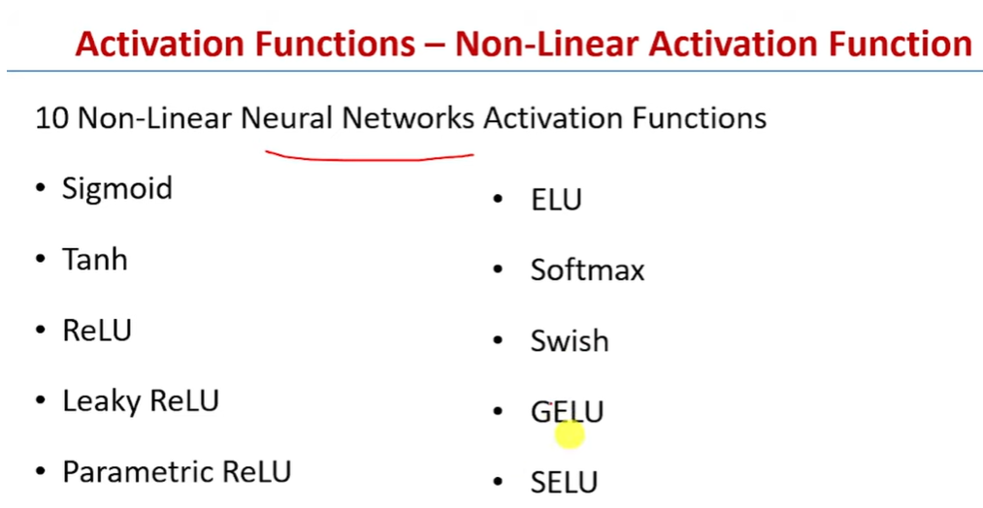

Slide 42
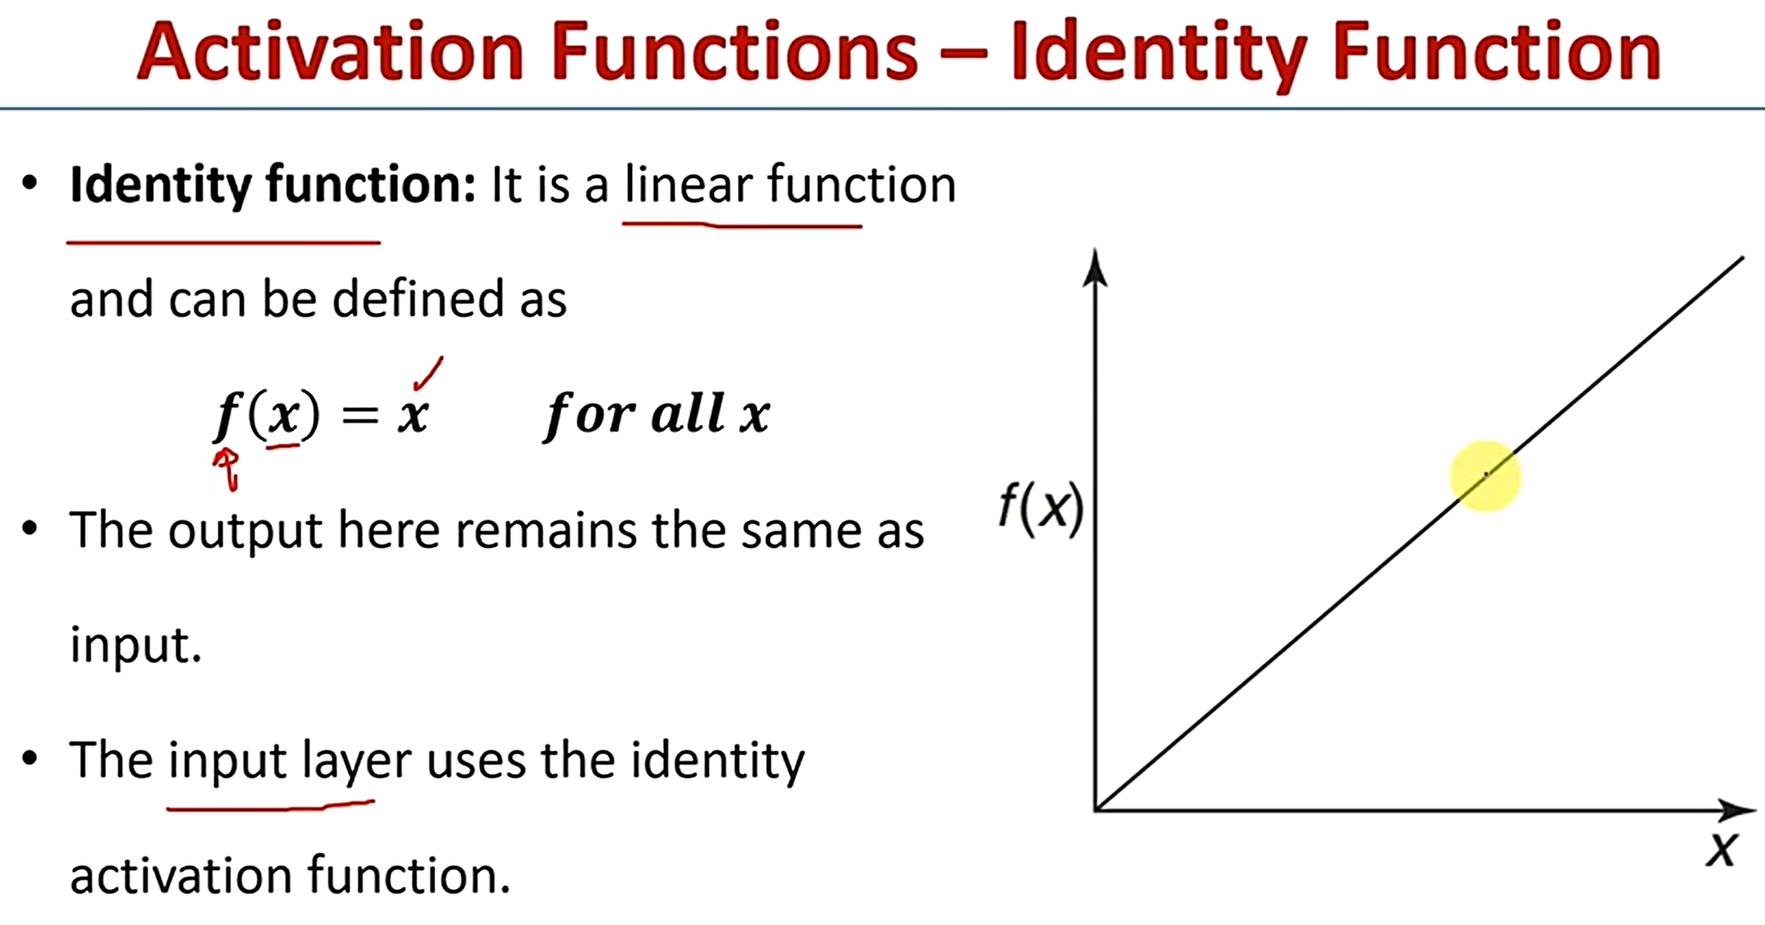

Slide 43
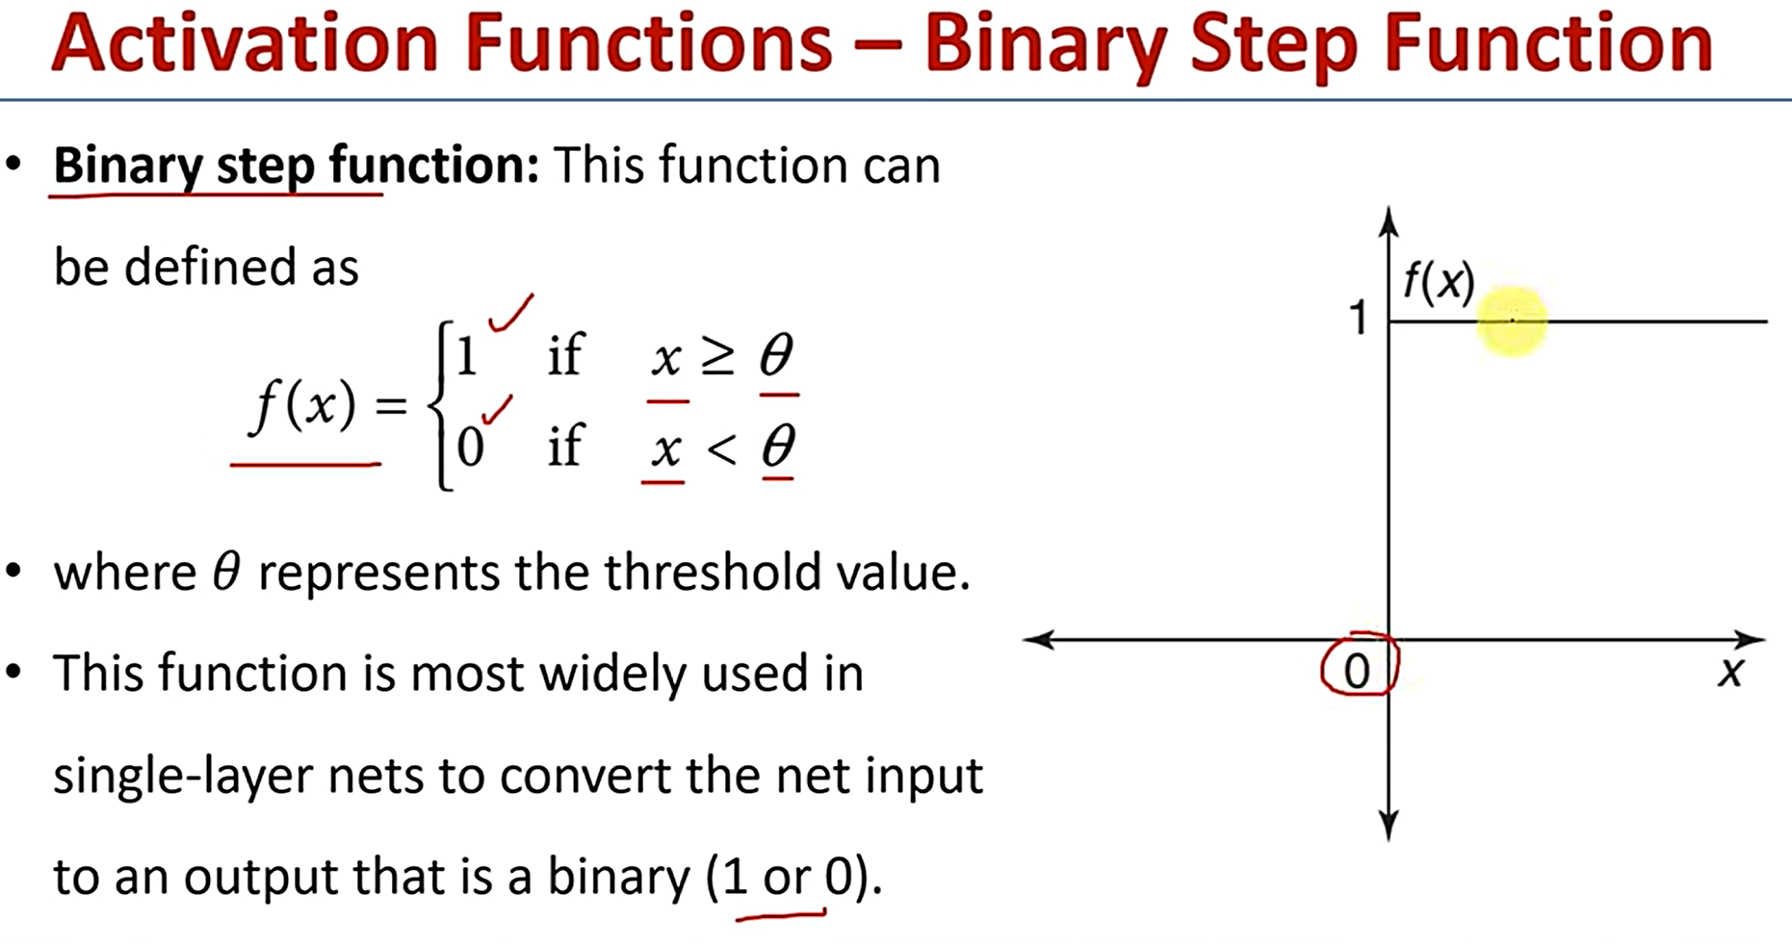

Slide 44
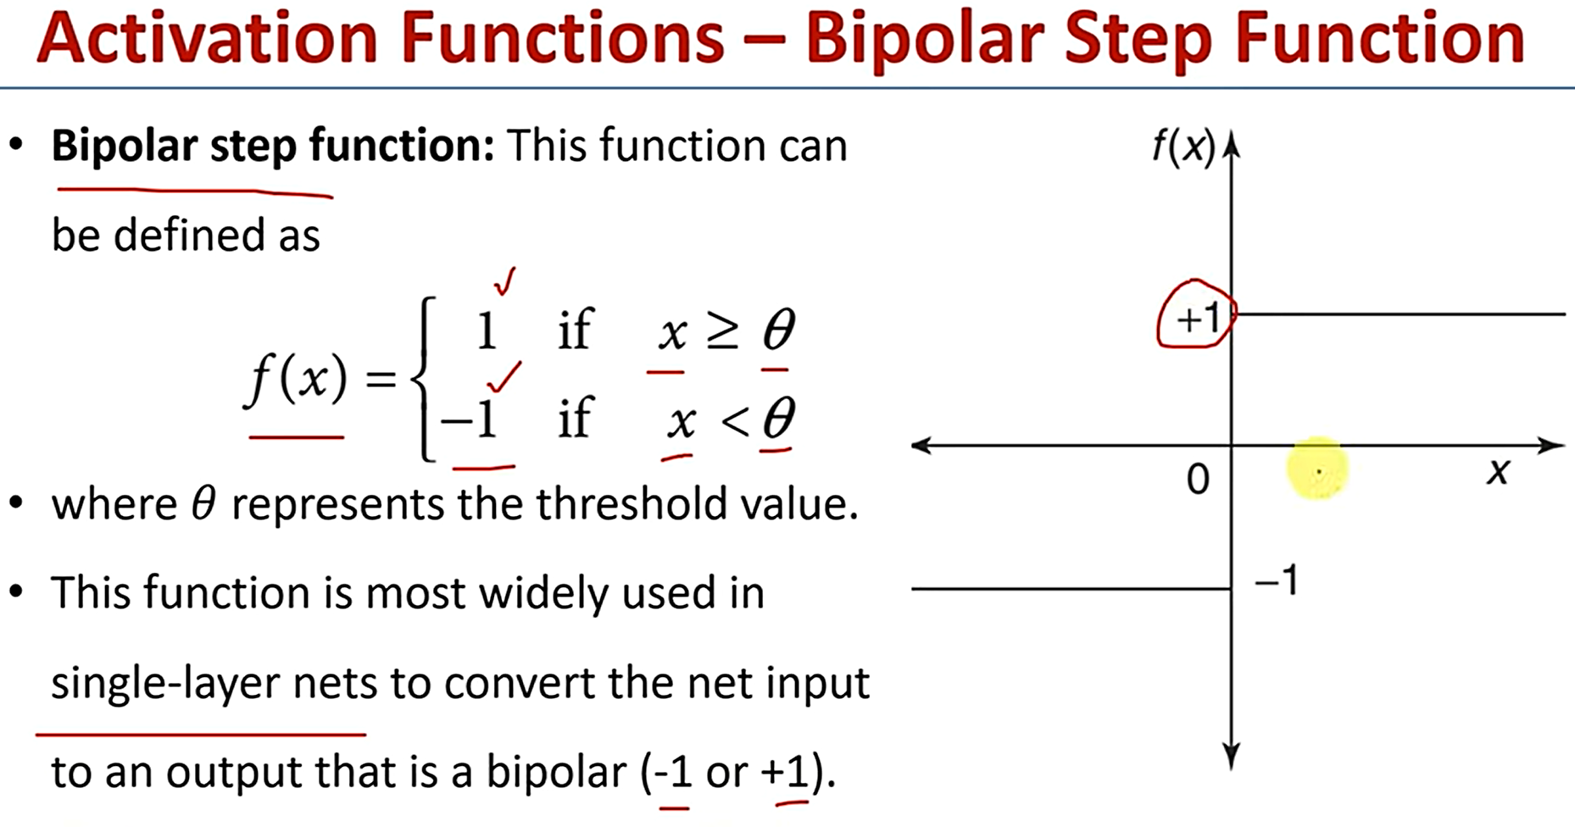

Slide 45
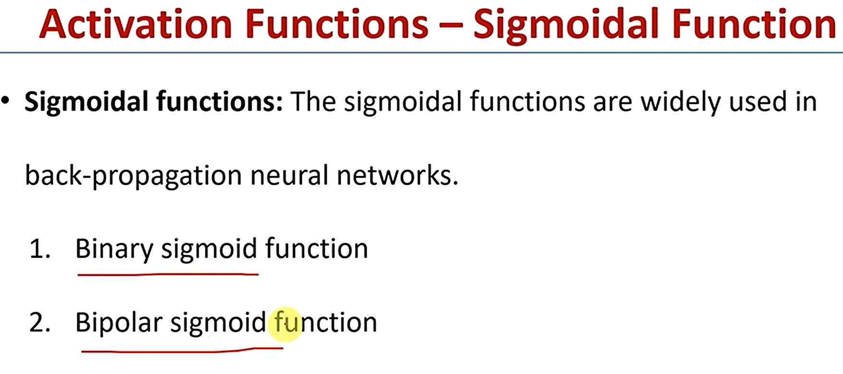

Slide 46
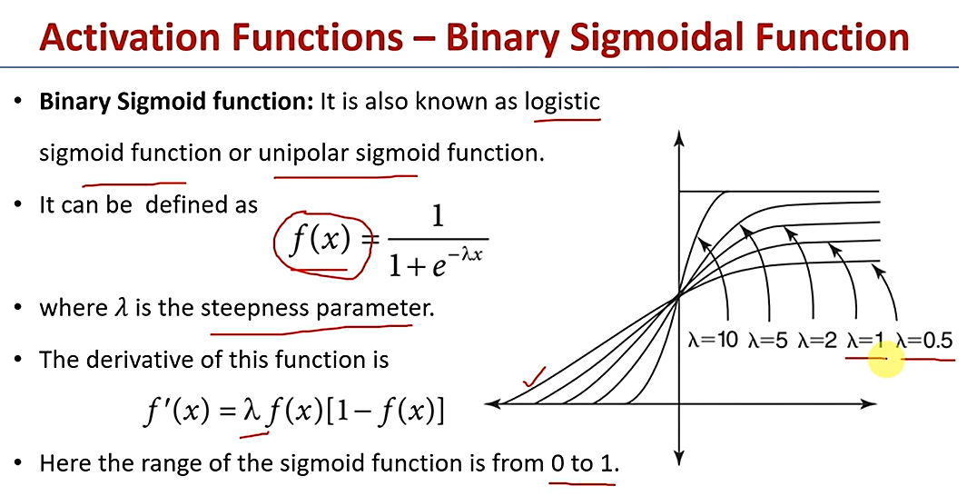

Slide 47
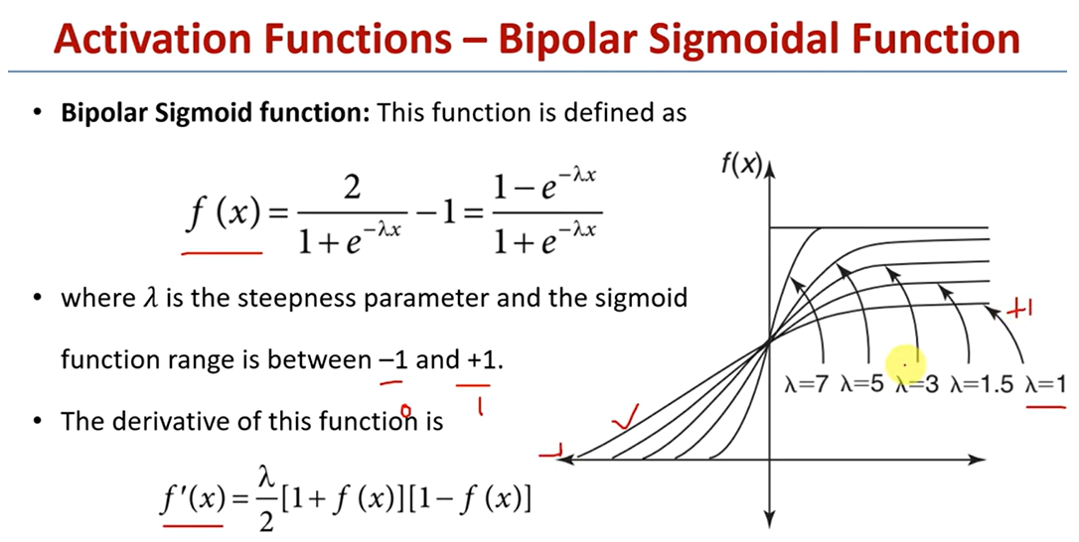

Slide 48
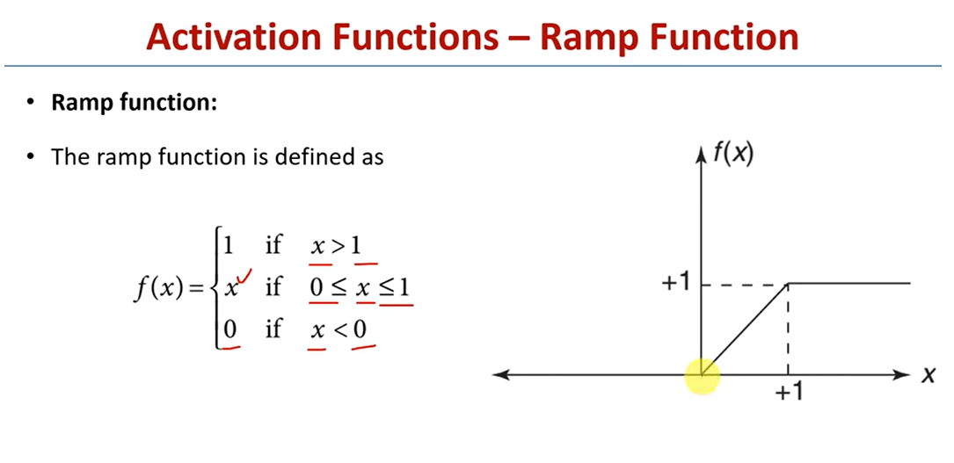

Slide 49
Radial Basis Function (RBF) Neural Networks
RBF network in its simplest form is a three-layer feedforward neural network. The first layer corresponds to the inputs of the network, the second is a hidden layer consisting of a number of RBF non-linear activation units, and the last one corresponds to the final output of the network. Activation functions in RBFNs are conventionally implemented as Gaussian functions.
A Radial Basis Function (RBF), also known as kernel function, is applied to the distance to calculate every neuron's weight (influence). The name of the Radial Basis Function comes from the radius distance, which is the argument to the function. Weight = RBF[distance)The greater the distance of a neuron from the point being evaluated, the less influence (weight) it has.

Slide 50
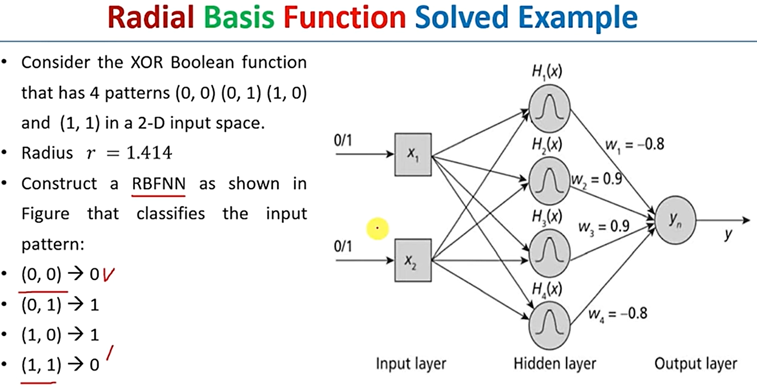

Slide 51
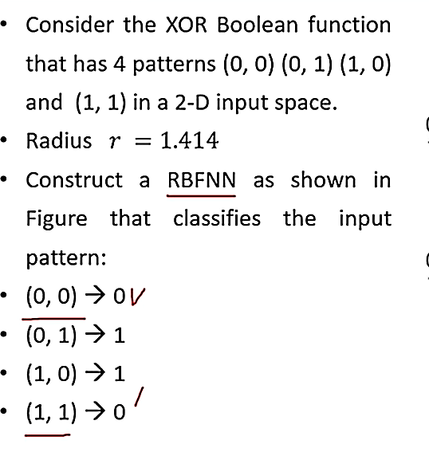
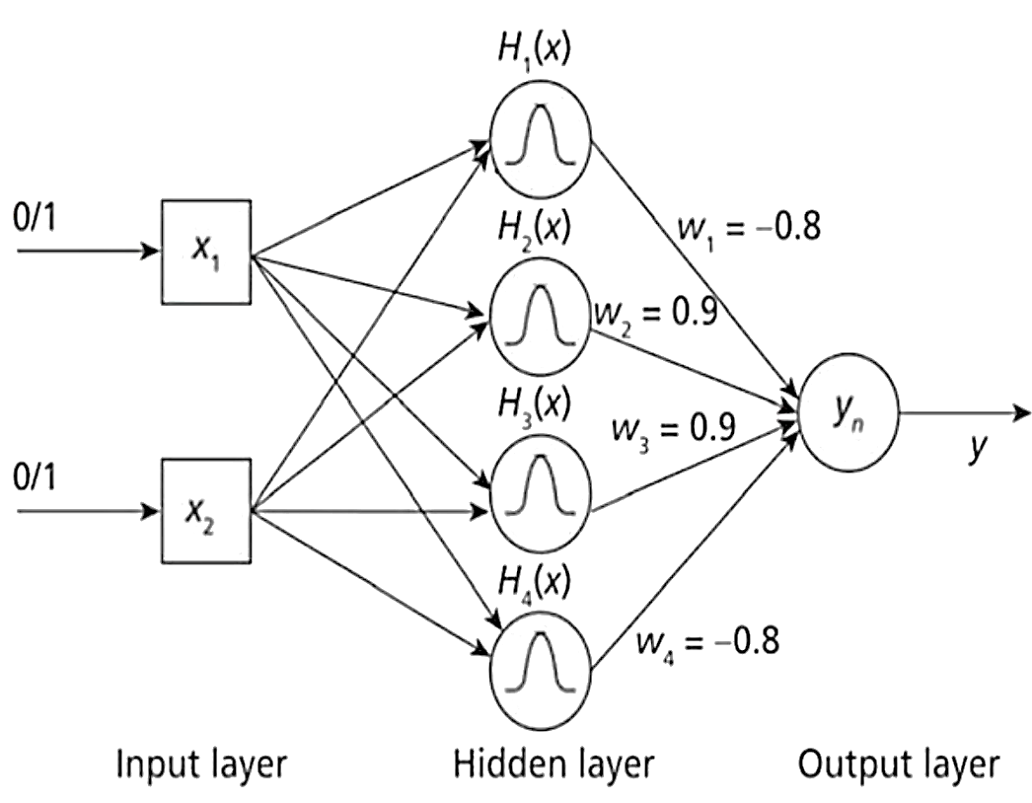
Consider the XOR Boolean function that has patterns (0, 0) (0, 1) ((1, 0) and (1, 1) in a 2-D input space. Radius is r=1.414. Construct a Radial Basis Function Neural Network as shown in the Figure that classifies the input pattern:
(0, 0) -> 0
(0, 1) ->1
(1, 0) ->1
(1, 1) ->0

Slide 52
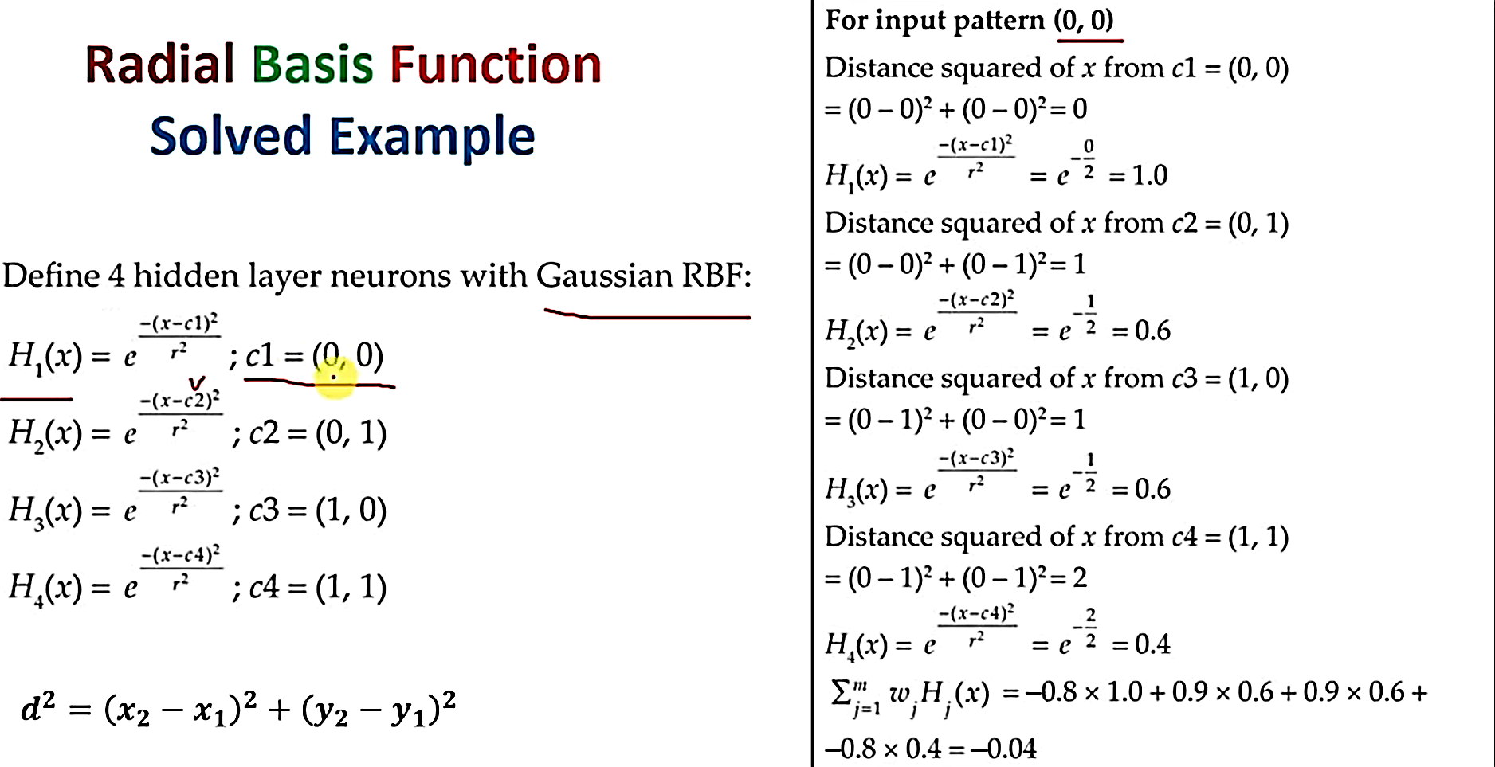

Slide 53
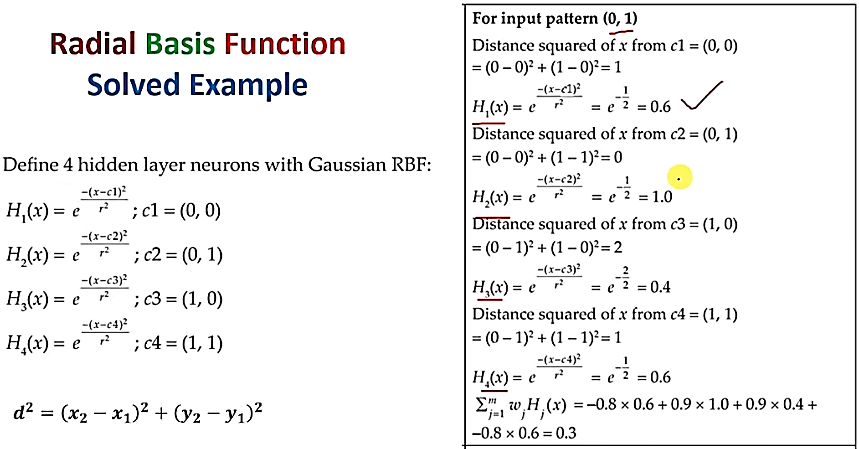

Slide 54
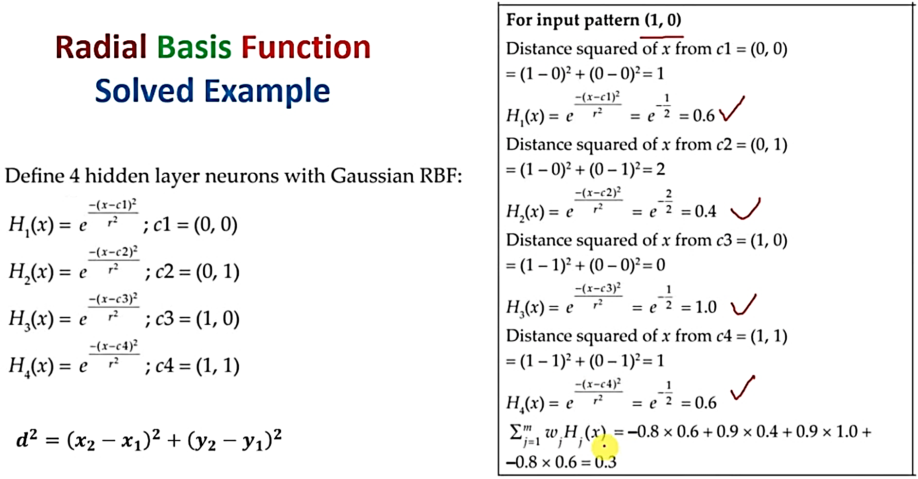

Slide 55
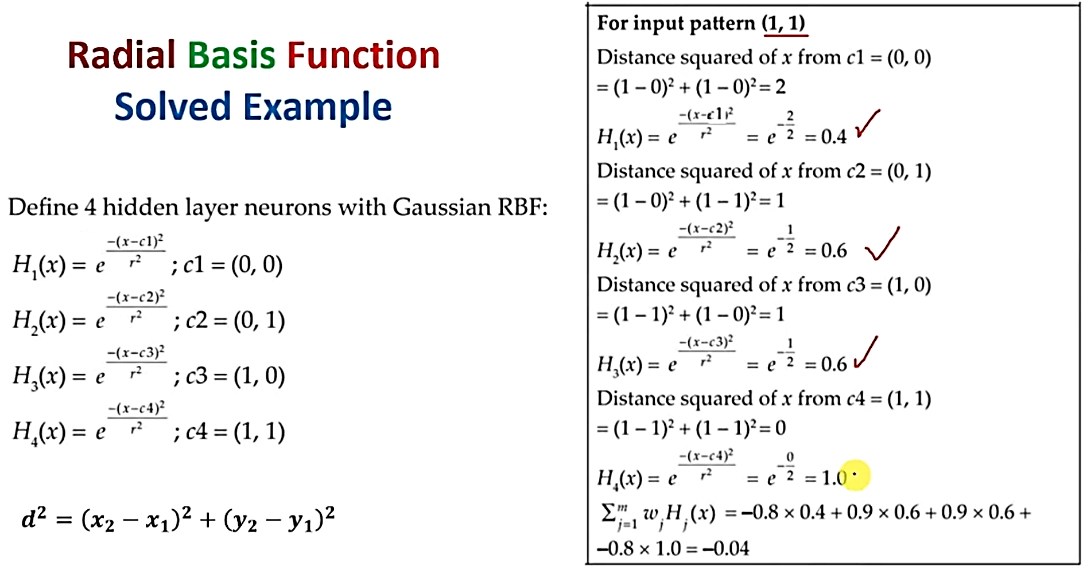

Slide 56
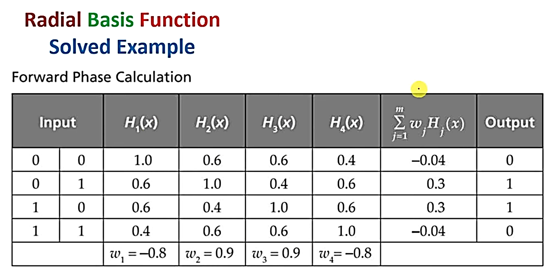

Slide 57
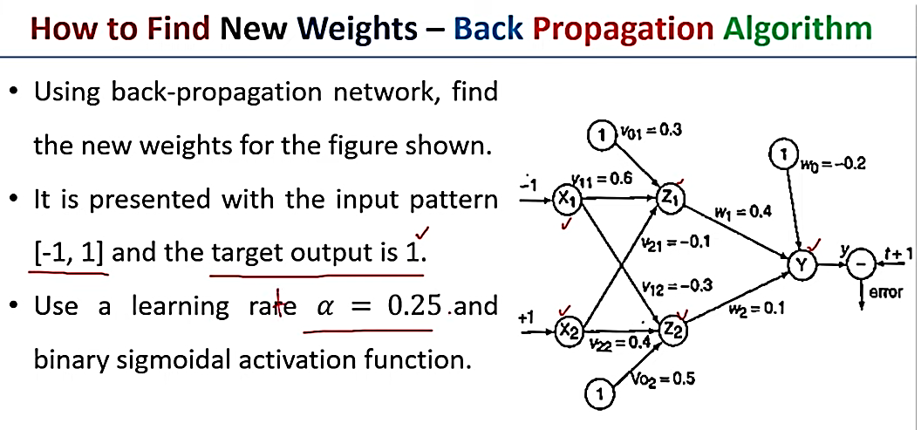

Slide 58
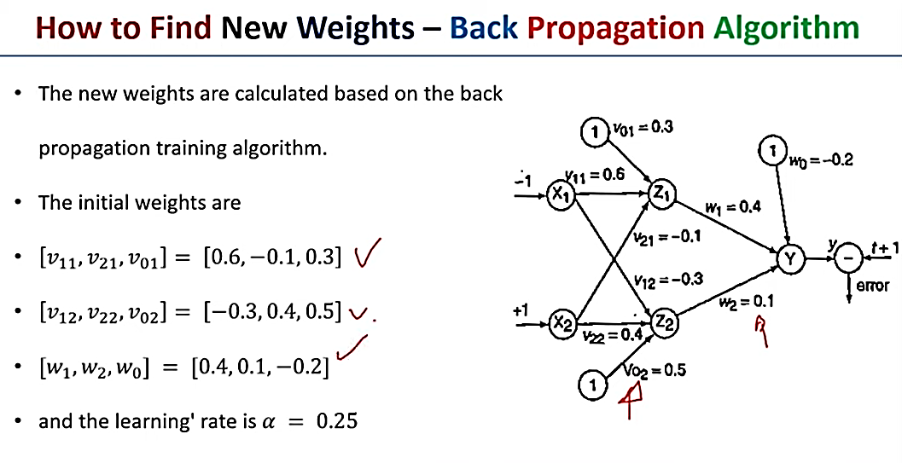

Slide 59
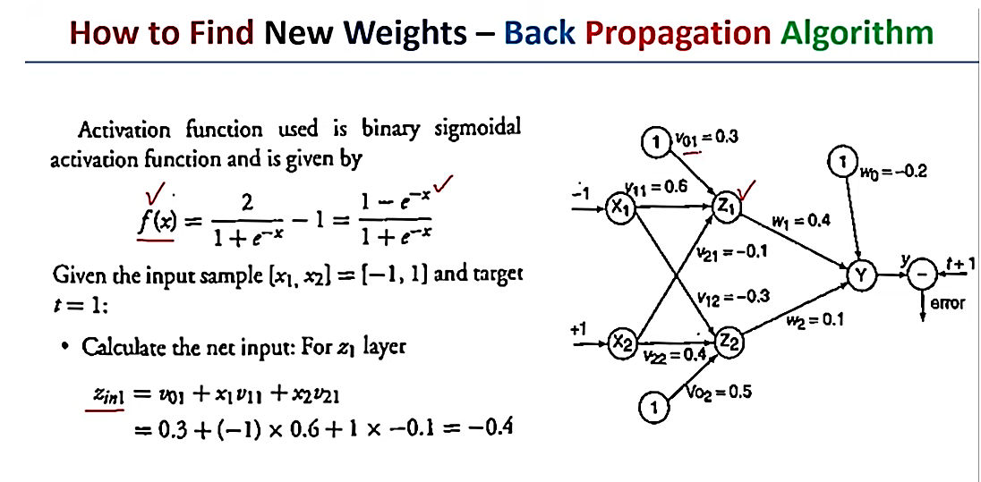

Slide 60
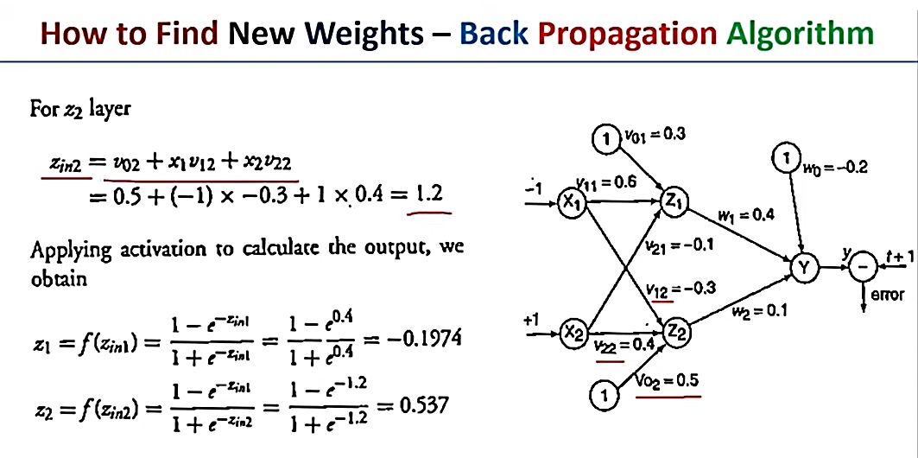

Slide 61
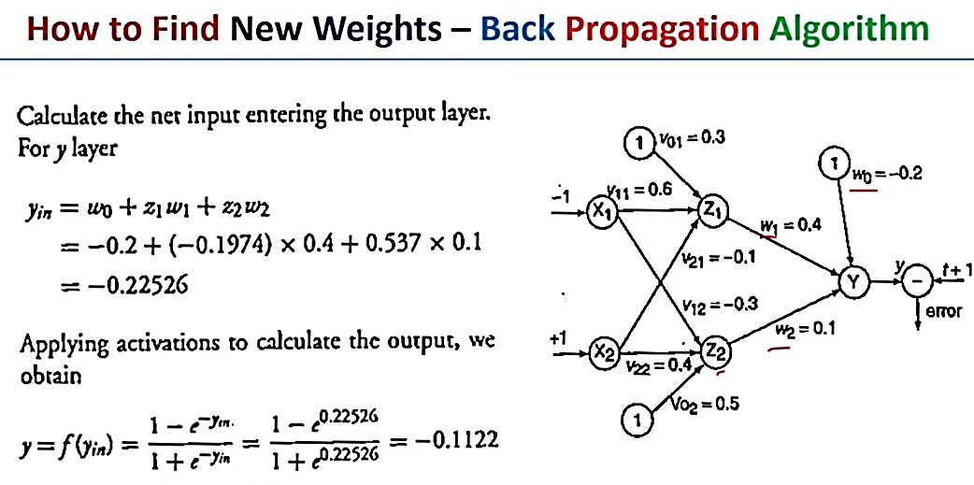

Slide 62
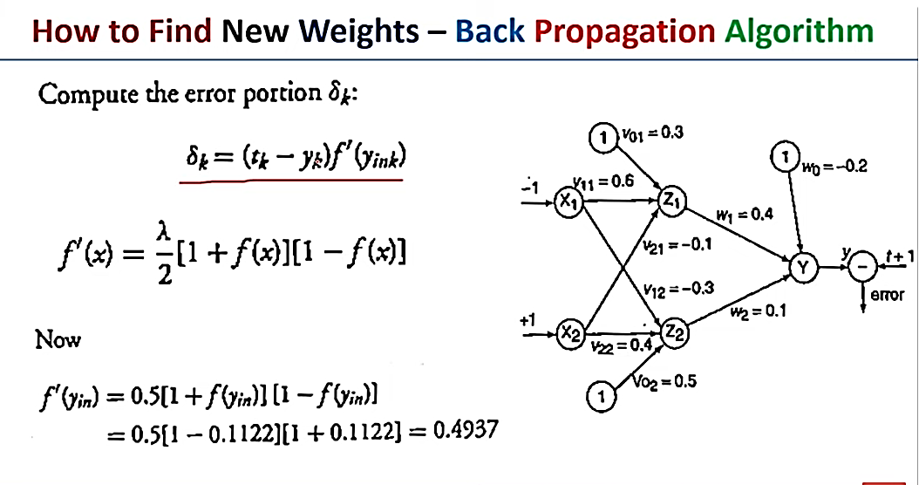

Slide 63
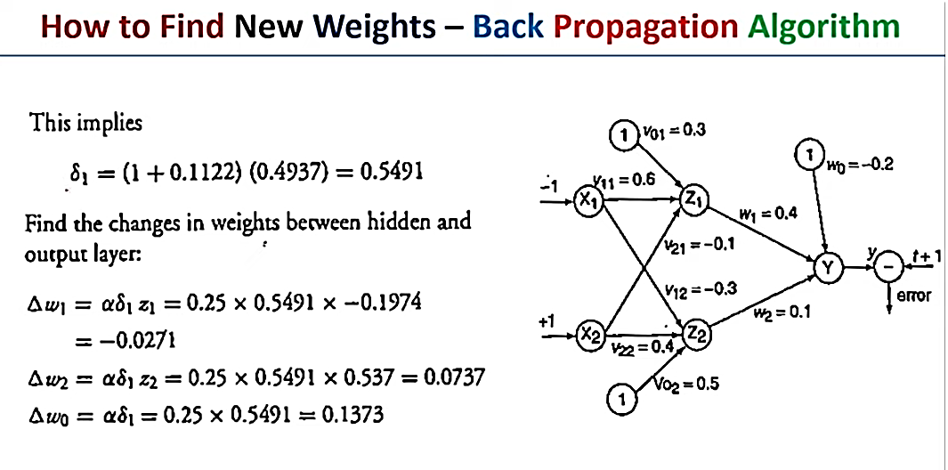

Slide 64
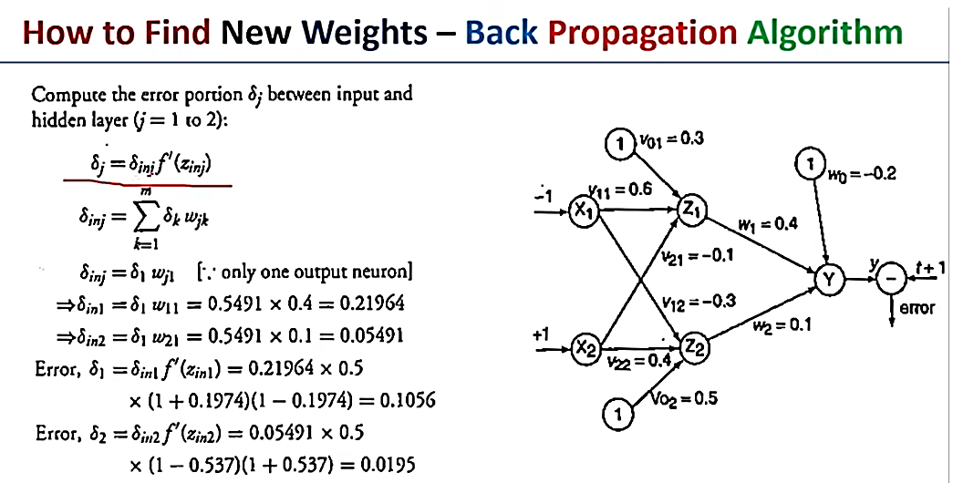

Slide 65
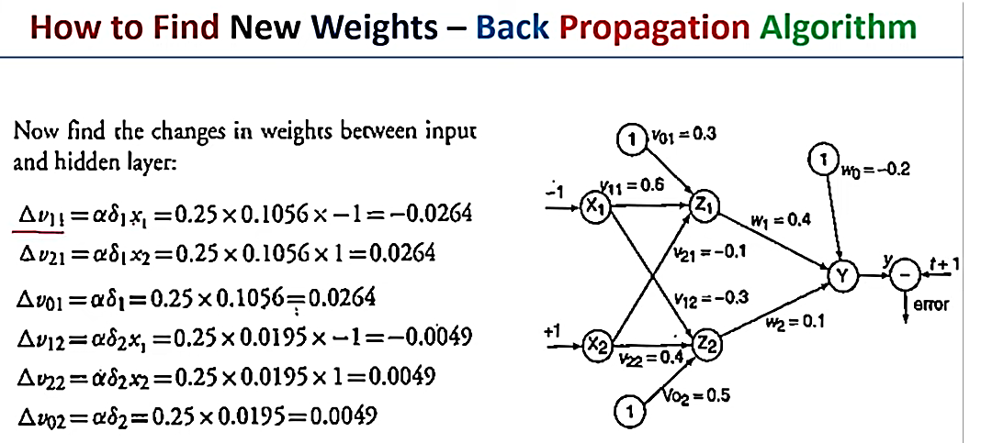

Slide 66
What is the difference between Perceptron and Multi-layer Perceptron?
The Perceptron is a single-layer neural network used for binary classification, learning linearly separable patterns. In contrast, a Multi-layer Perceptron (MLP) has multiple layers, enabling it to learn complex, non-linear relationships. MLPs have input, hidden, and output layers, allowing them to handle more intricate tasks compared to the simpler Perceptron.

Slide 67
How does the network learn?
The training samples are passed through the network and the output obtained from the network is compared with the actual output. This error is used to change the weights of the neurons such that the error decreases gradually. This is done using the Backpropagation algorithm, also called backprop. Iteratively passing batches of data through the network and updating the weights, so that the error is decreased, is known as Stochastic Gradient Descent ( SGD ). The amount by which the weights are changed is determined by a parameter called Learning rate.

Slide 68
Thank You

